Slide 1
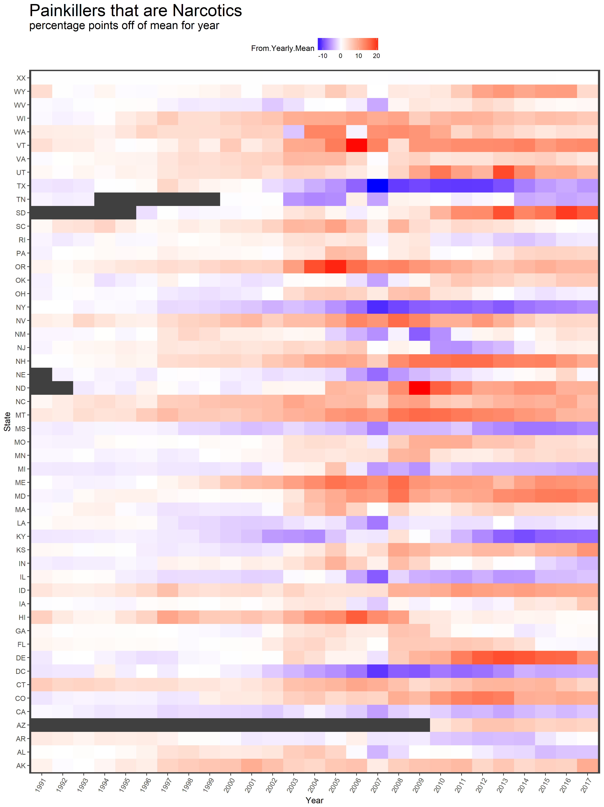
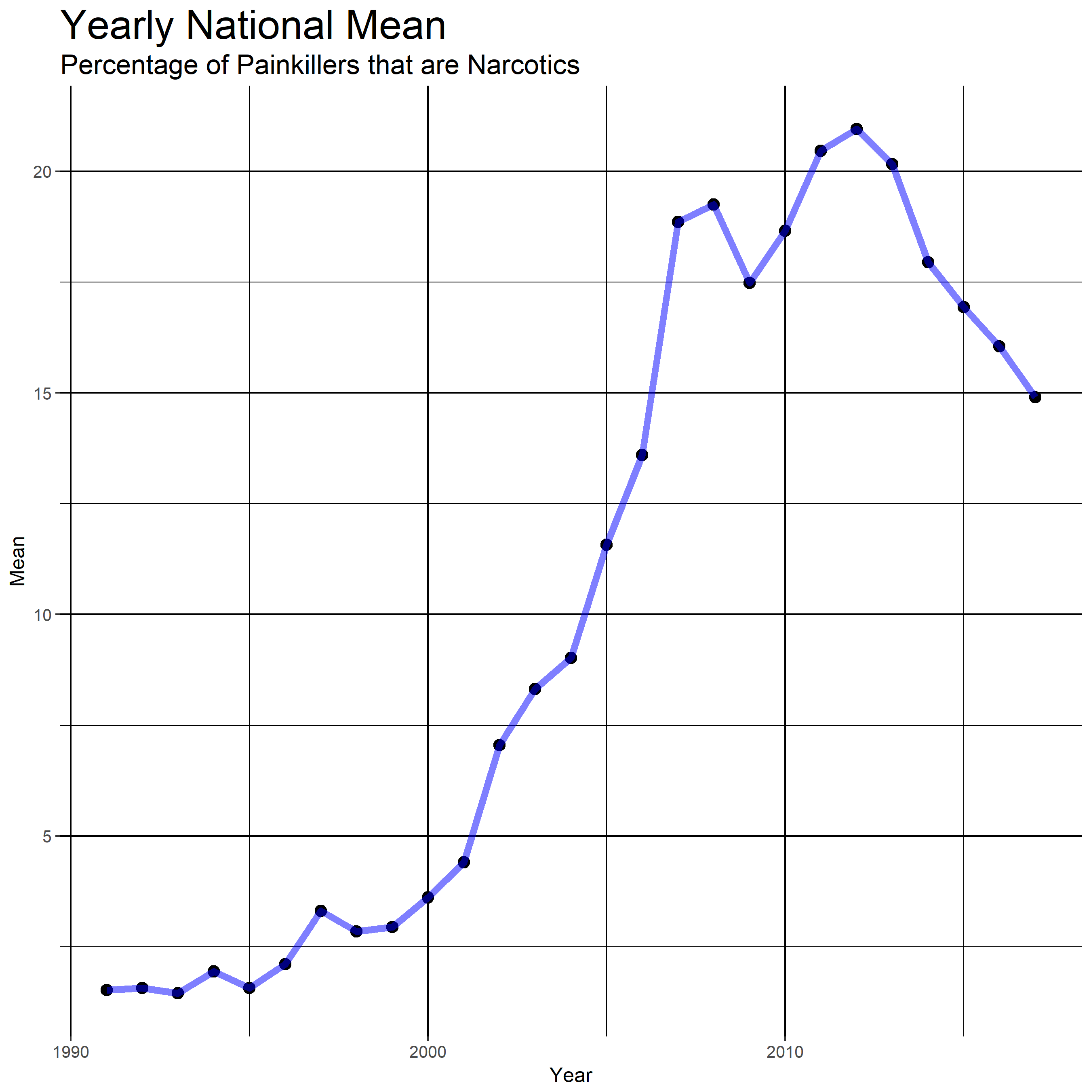
United States Prescription Drug Monitoring Programs
Chistopher Au, Student Pharmacist, and Omair Khan, Student Pharmacist
St. Louis College of Pharmacy, St. Louis, Missouri
Based on trends starting from the year in which PDMPs were established in each state, approximately 19 states showed a downward trend relative to the national mean. Of those, 6 states presented with a downward trend several years before a PDMP was enacted. 12 states presented with relatively stable trends, with little deviation from their place relative to the national mean. 5 states demonstrated an upwards trend, with PDMPs having little effect on curbing perscribing habits. The data from 13 states was unusable due to PDMP establishment years either too far in the past or too recent. Delaware was an exception due to its very unstable trend. Missouri was excluded due to a lack of PDMP in the state even today.
Introduction
Opioid abuse and overprescribing has been a trending topic in the United States for the past several years. With the recent declaration of opioid abuse as a national emergency, the topic has become a greater talking point than ever before. The Prescription Drug Monitoring Program (PDMP) has been around for decades, but state governments have recently begun implementing them in greater urgency. Many states have implemented PDMPs within the past decade as a means of monitoring and controlling prescribing practices. The question is, do PDMPs have a pronounced effect on prescribing practices? PDMPs allow pharmacists and prescribers to check if patients have been prescribed controlled substances to prevent concomitant therapy. They also allow the government to observe prescribing habits of providers and initiate corrective measures if needed. These data-driven interventions theoretically should decrease the number of narcotics prescribed as a percentage of pain-relief therapy, which the following research seeks to verify or disprove.
Methods
The statistics program R was used to manipulate data obtained from the Medicaid website. Entire datasets ranging from 1991 to 2017 were analyzed by the R script available on the associated GitHub page (github page reference). Specific drugs were selected as painkillers based on their use for pain relief and as a muscle relaxant. Narcotics were selected based on their function on the opiate pathway specifically. NDC information was obtained from the FDA website and linked to the obtained Medicaid datasets. Narcotic painkiller prescriptions were compared to other painkiller options across years and states. Data regarding years that PDMP systems were implemented were harvested from state specific PDMP and legislature websites.
Conclusion
Based upon the Medicaid data from recent years, it seems to be the case that PDMPs are part of a solution, but not the entire cure. In many states that implemented PDMPs, there has been an appreciable downward trend in prescribing habits relative to the nation as a whole. Unfortunately this is not the case in all states. Some states have seen continuing upward trends relative to the national average in narcotic prescribing, which is indicative of a problem that is not improving. While some states remain stable relative to the national average, with the national average decreasing this is still a promising observation. The findings suggest that continuing efforts in monitoring prescribing habits in conjunction with other solutions may curb the rise in narcotic prescriptions and help alleviate the opioid epidemic.
Works Cited
Schuchat A, Guy GP Jr, Dowell D. Prescription Drug Monitoring Programs and Opioid Death Rates-Reply. JAMA. 2017 Nov 28;318(20):2045.
“Prescription Drug Monitoring Frequently Asked Questions (FAQ) | The PDMP Training and Technical Assistance Center.” Www.pdmpassist.org, www.pdmpassist.org/content/prescription-drug-monitoring-frequently-asked-questions-faq
“State Drug Utilization Data.” Medicaid.gov, www.medicaid.gov/medicaid/prescription-drugs/state-drug-utilization-data/index.html.
https://github.com/Ory-Data-Science/final-project-chris-and-omair
Contribution
Chris Au – Coding / editing
Omair Khan -- Poster
Results
Based on the data compiled from Medicaid, conclusions were drawn regarding prescribing trends following years in which PDMPs were established in each state. A heatmap is presented which displays how many percentage points each state was off of the national mean by year. The color scheme used ranges from blue to red, with white in the middle. States below the national average become a progressively darker shade of blue while states above the national average become a deeper shade of red. Black boxes indicate years in which no data was acquired for that state. The line graph displays the national mean by year. It can be observed that there is a strong increase in opiate use starting from around the year 2000 upwards. This peaks at 2012 and then finally makes a descent to our current values.
.

